Slide 1
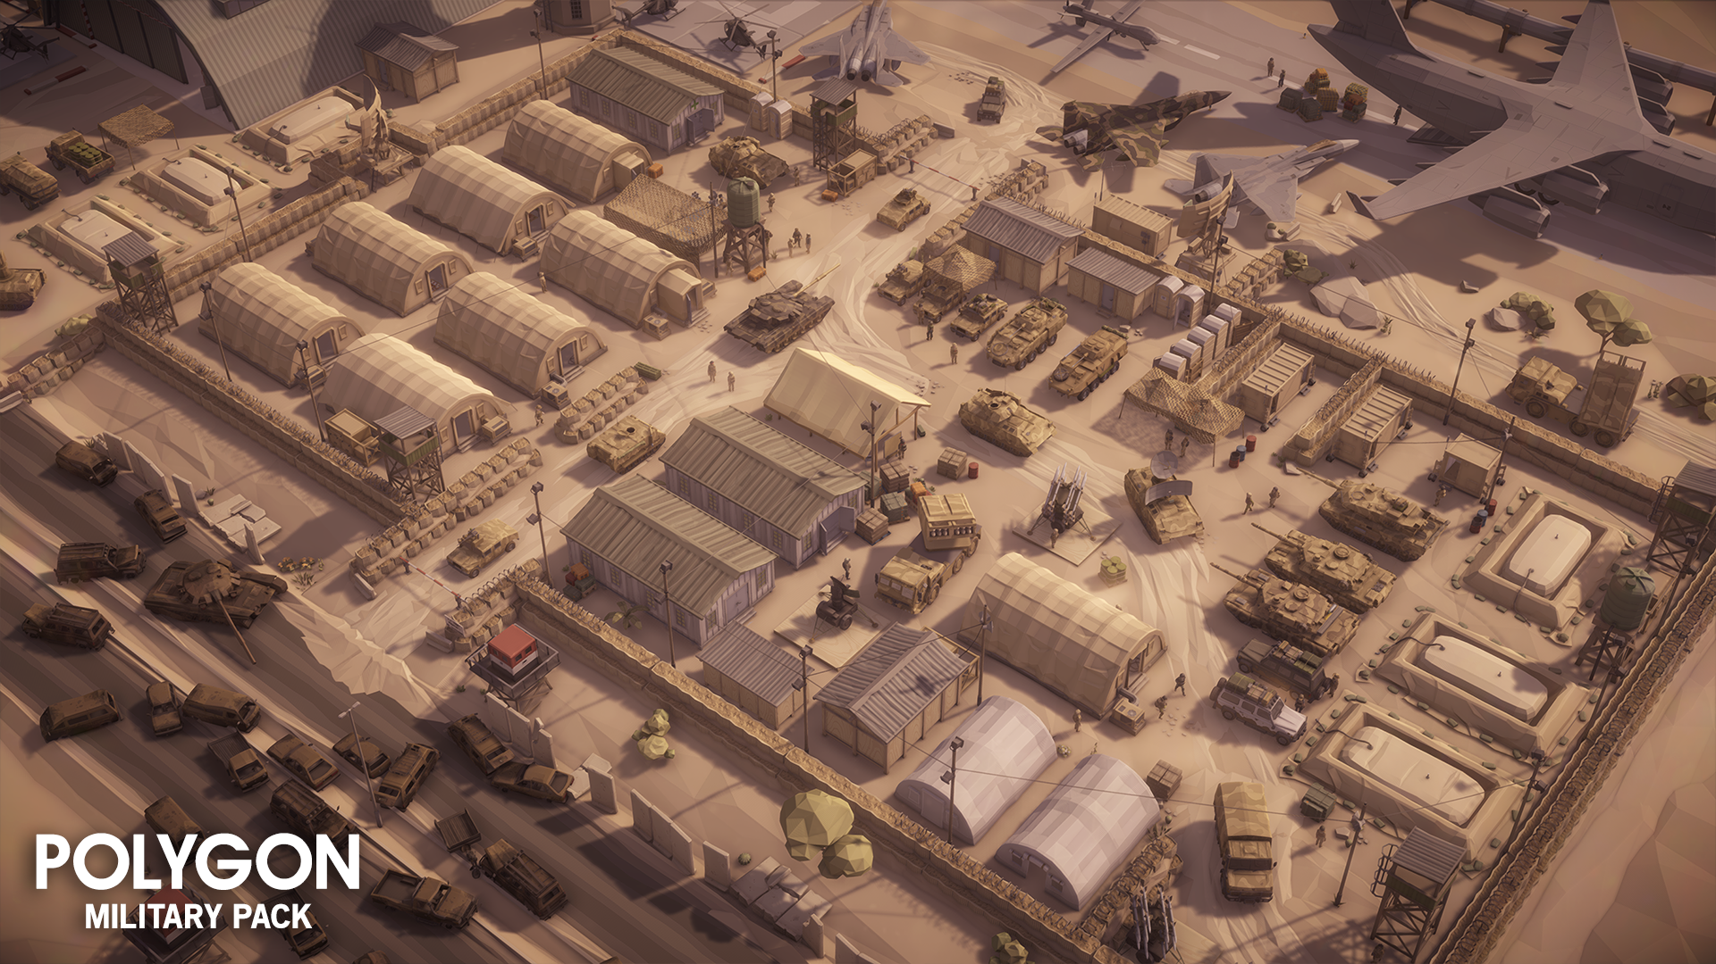
Minor Skilled Evaluation presentation 1
Nils Meijer

Slide 2
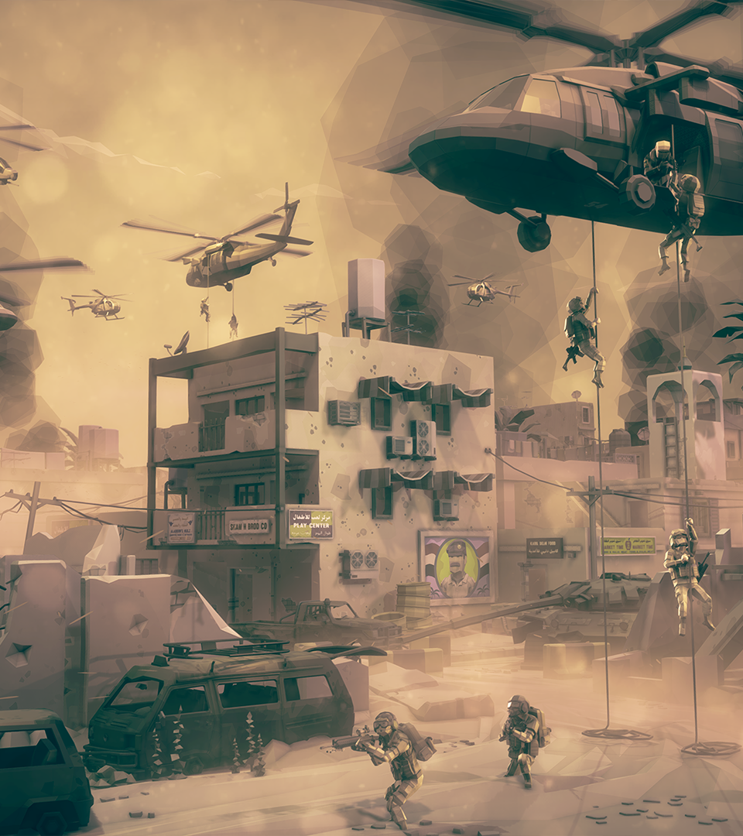
What were my ideas?
Synty asset pack
Gun range
Tank simulator (final choice)
Action game
AI behaviour
Potential future jobs
AI programmer
Gameplay programmer
Tool programmer

Slide 3
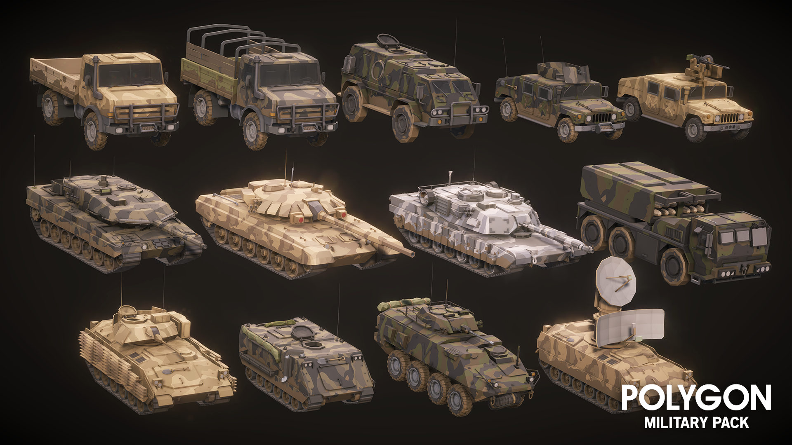
What did I work on?
Week 1
Brainstorming
Research
Started programming Tank Controller components
Week 2
Movement component
Custom editor
Camera controller
Shooting component
Week 3
Shooting component
Damage registration system
Week 4(.5)
Research
Reworked movement component (gear shifting)

Slide 4
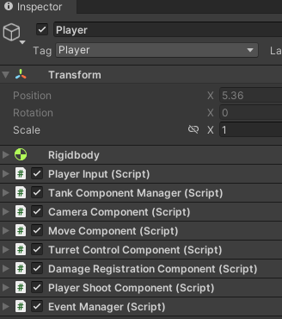
How did it work out?
Researched several tank-related games
Gunner Heat PC, Warthunder, World of Tanks
Implementing features by breaking down into goals > subgoals
Example: Tank Controller
Move component
Subgoals:
Custom editor window
Tank tracks (wheel colliders)
Gear shifting system
Turret control component
Subgoals:
Turret rotation
Barrel/cannon rotation
Camera Component
Subgoals:
ADS
1ST person
3rd person

Slide 5
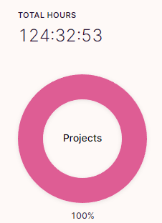
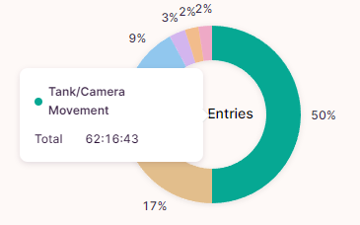
Planning
Toggl hours tracking
Agile workflow - feature-driven development (previous slide)
Set goals to achieve and skills to learn

Slide 6
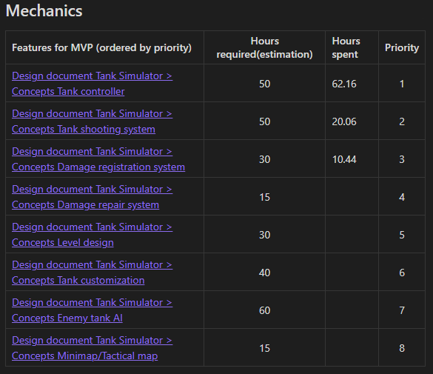
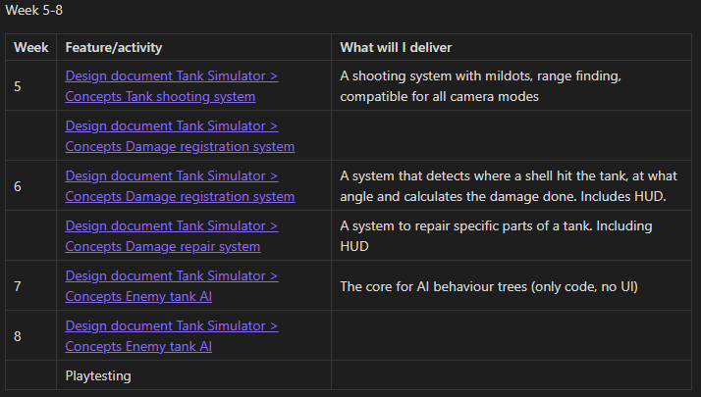
Planning
Planning specifies:
Priority
Per week
Feature
What will I deliver
Planning 4/5 weeks ahead at a time
Planning until next evaluation ->

Slide 7
Quality Assurance
Former colleague/lead developer Total Reality
Feedback gathered, but not enough time to apply all of it (the meeting was last night).
Emailed several studios developing tank simulators
For the rest of the minor:
Preferably multiple meetings with Quality Assurer(s?)
Playtests

Slide 8
What I can do better – self reflection
Update/increase hour estimations if:
Things take longer than expected
Features are implemented differently than expected
Be mindful of getting side-tracked (working on other features at the same time)
More detailed hour registrations - know exactly what I did on a day

